Slide 1




CQRS with Erlang
presented by Bryan Hunter Firefly Logic
Twitter #erlang #cqrs
#ndcoslo
@bryan_hunter
@fireflylogic

Slide 2
?

Slide 3
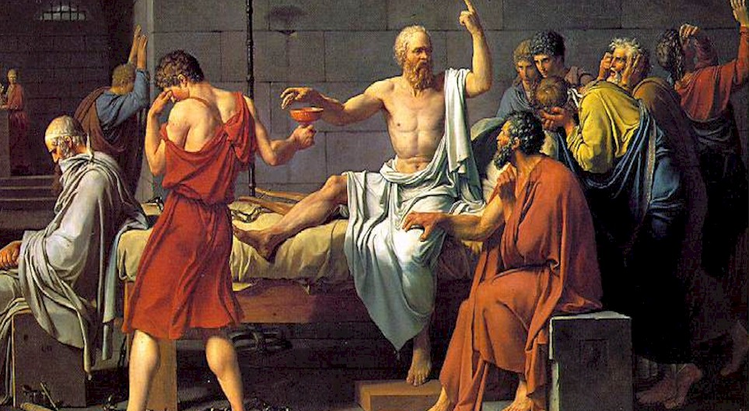
I’ll have one more of these… umm… what am I drinking?

Slide 4
What and why CQRS?

Slide 5
Command Query Responsibility Segregation
> What is CQRS?

Slide 6
CQRS is an architectural pattern
> What is CQRS?

Slide 7

Command Query Separation (CQS) applied to the “big”
void MutateSomeState(…); - or - MyResult GetWithoutTouching(…);
> What is CQRS?
Notes:
http://commons.wikimedia.org/wiki/File:Old_book_bindings.jpg

Slide 8
CQRS is about separating reads from writes
> What is CQRS?

Slide 9
CQRS is about heresy
> What is CQRS?

Slide 10
Why CQRS?

Slide 11

> Why CQRS?
Domain Driven Design
Your heart says “it’s the right thing”
…but your brain says “you’re a big stinkin’ fraud”

Slide 12
> Why CQRS?
Bog standard
Layered Architecture
(not CQRS)
SQL
ORM
“Aggregate”<T> ☺
Repository<T>
DTOs
Two way data binding
Client
ConcurrencyException
load()
{
this.DataSource = _service.GetData();
}
save()
{
_service.Save(this.Data); }
Notes:
TODO:

Slide 13

> How CQRS?
Task-based UI
Read store
Command

Slide 14
> How CQRS?
CQRS (as a cycle)
Events
Read-store
Command
Write-store
UI

Slide 15
> How CQRS?
Analytics store
CQRS (more details)
Event store
Queue
Read store
EventHandler
Event
EventHandler
EventHandler
Aggregate
Command Handler
DTO
Queue
Legacy store
Command
Client
Readonly
Command Builders
Tasks

Slide 16
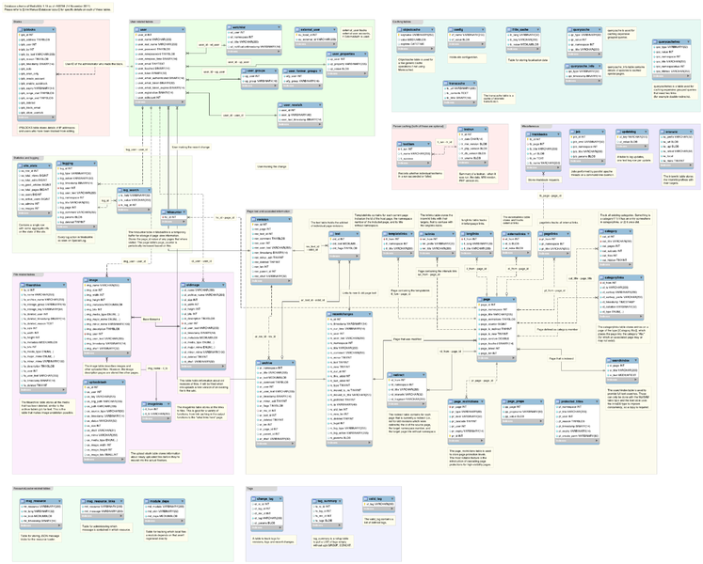
> Why CQRS?
keep your privates private

Slide 17
> Why CQRS?
CQRS (roles)
Analytics store
Event store
Queue
Legacy store
Read store
EventHandler
Event
EventHandler
Aggregate
EventHandler
Command Handler
DTO
Queue
Command
Client
Readonly
Command Builders
Tasks

Slide 18

> Why CQRS?
returns focus to the business

Slide 19

> Why CQRS?
Vendor relationships should be consensual

Slide 20
> Why CQRS?
$
$
$
$
$
$
$
$
$
$
$
$
$
$
scaling up
scaling out
¢
¢
¢
¢
¢
¢
¢
¢
¢
¢

Slide 21

> Why CQRS?
SLAs? Explicit & tunable

Slide 22
> Why CQRS?
Let the business tweak CAP
Partition tolerant
Consistent
Available

Slide 23
> Why CQRS?
simplify conflicts, read-write contention, and concurrency
9
0
1
2
3
4
5
6
7
8
{moved, 200203, …}
{deposited, 21203, 100}
{loanOfferSent, 200203}
{deposited, 21203, 100}
{deposited, 21203, 100}
{deposited, 200203, 1000}
{accountCreated, 21203}
{overdrafted, 200203, 50}
{withdrawn, 200203, 350}

Slide 24

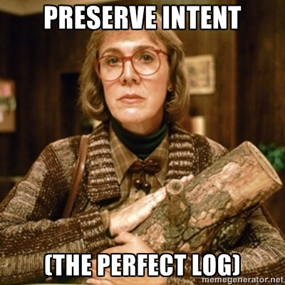
> Why CQRS?
http://memegenerator.net/Twin-Peaks-Log-Lady

Slide 25

> Why CQRS?
Our one chance to
to get it right
Big Design Upfront YAGNI Just-in-Time
Future-proof Maintenance

Slide 26

> Why CQRS?
Monoliths typically aren’t this helpful
Predictive analytics
mission-critical 24/7 3,000 TPS
Monthly batch
MVC & Entity Framework
Active-record smart-UI
Ad-hoc SQL

Slide 27
Why Erlang?

Slide 28
> Why Erlang?
Erlang is open, proven and cross-platform. It simplifies writing reliable, concurrent, distributed systems. Its pattern matching is FTW.

Slide 29
Erlang Runtime System (in-context)
.NET dev stack
Erlang dev stack
C# / F#
Erlang / Elixir
.NET Framework
OTP
250+ years
CLR
ERTS
VM + Kernel
+ STDLIB
OS (Windows)
OS (Windows, Linux, Mac, None)

Slide 30
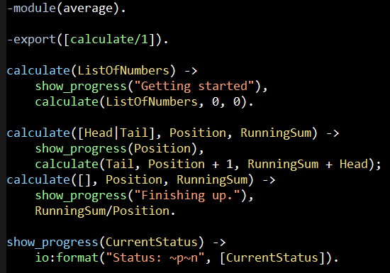
Erlang (the Language)
File: average.erl

Slide 31
“The performance
of a concurrent language
is predicated by three things:
the context switching time,
The message passing time,
and the time to create a process.”
–Mike Williams

Slide 32
One Java 6 or .NET 4.0 Thread (allocates one megabyte)
**********
**********
**********
**********
**********
**********
**********
**********
**********
**********
**********
**********
**********
**********
**********
**********
**********
**********
**********
**********
**********
**********
**********
**********
**********
**********
**********
**********
**********
**********
**********
**********
**********
**********
**********
**********
**********
**********
**********
**********
**********
**********
**********
**********
**********
**********
**********
**********
**********
**********
Heap
Mailbox
Stack
**********
**********
**********
**********
**********
**********
**********
**********
**********
**********
**********
**********
**********
**********
**********
**********
**********
**********
**********
**********
**********
**********
**********
**********
**********
**********
**********
**********
**********
**********
**********
**********
**********
**********
**********
**********
**********
**********
**********
**********
**********
**********
**********
**********
**********
**********
**********
**********
**********
**********
Garbage Collector
Links and Monitors
One Erlang Process (allocates one kilobyte)
*
Why -> elsewhere concurrency is painful

Slide 33
*
*
*
Reductions
- Do 2,000 operations
reduction1 reduction3 .
Reduction2000
- Move to the next guy - Repeat
CPU Core
Why -> near zero context switching cost

Slide 34
worker
supervisor
*
*
CPU Core
Why -> supervision

Slide 35
***** *****
***** *****
***** *****
***** *****
Core
Core
Core
Core
Why -> elsewhere concurrency is painful

Slide 36

Distribution: built-in from the start

Slide 37

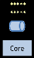
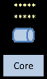
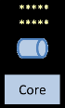
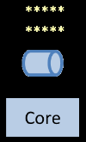
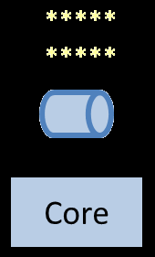
Distribution: built-in from the start

Slide 38
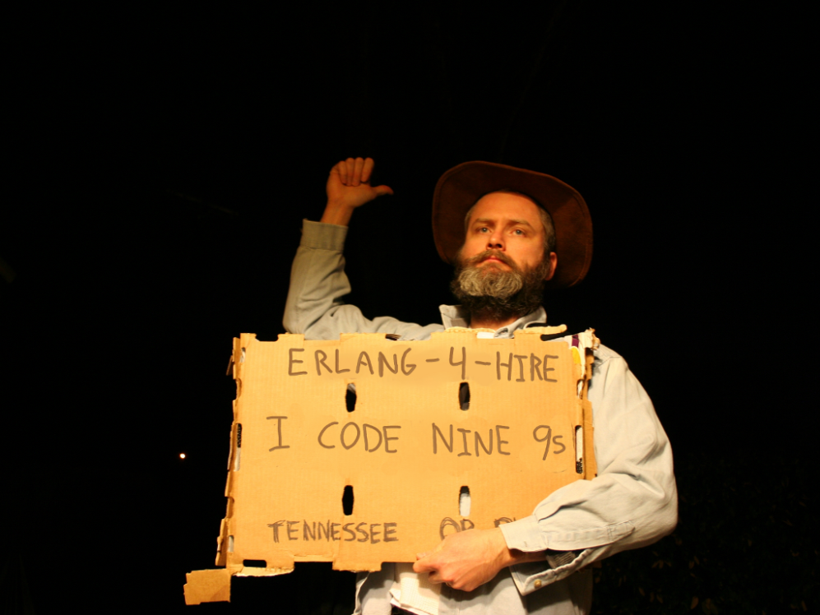
Nines | Uptime | Annual Downtime
9 | 99.9999999% | 30 milliseconds
8 | 99.9999990% | 300 milliseconds
7 | 99.9999900% | 3 seconds
6 | 99.9999000% | 32 seconds
5 | 99.9990000% | 5 minutes
4 | 99.9900000% | 53 minutes
3 | 99.9000000% | 8 hours, 46 minutes
2 | 99.0000000% | 3 days, 15 hours, 36 minutes
Safe
Supervisor
Worker
Worker
Links and monitors
No masters
Hot code loading
simple distribution, safe concurrency
Why -> reliability

Slide 39
[insert awe-inspiring demo here]
Notes:
http://www.dccomics.com/tv/super-friends-1973-1974

Slide 40














When you reach for CQRS you are solving problems that led these companies
to
…to
Notes:
Horizontally scalable reads
Dialing SLA

Slide 41
Concurrency and Parallelism
Notes:
To start off let’s discuss concurrency and parallelism…

Slide 42
Why?
1986
2006
≠
Concurrency
Parallelism
structure
execution
lots of things at once
Notes:
Concurrency is not parallelism.
<bump> Concurrency is about structuring your program so that you can deal with lots of things at once
<bump> Parallelism is about the execution of lots of things at once.
You cannot have parallelism on a single-core, single threaded-machine. You can however have concurrency on a single-core, single threaded-machine. If you have zero concurrency in your solution you will have zero parallelism in your solution even is you add mores cores.
<bump>
If you remember from Module 1, Erlang was invented in 1986. The first major release of Erlang with SMP (Symmetrical Multi Processor) support came twenty years later in 2006.
Why?
<bump>Why was concurrency so important even without parallelism? To better understand let’s compare concurrency models.

Slide 43
Most Languages Use Threads
Notes:
Most languages expose the underlying operating system’s threading model as their primary concurrency model.

Slide 44
Languages with Actor Model Libraries
Notes:
Some languages have attempted to address the problem of threads by bolting on actor-model libraries. In these languages you will start off execution in the main thread and when you want to spread some heavy work across multiple cores you flip modes and call into some flavor of actor model. Often times these languages will claim to support “Erlang-style concurrency”. By the end of this course the term “Erlang-style concurrency” should trigger an involuntary eye-roll or sigh.

Slide 45
Concurrency-Oriented Programming
Notes:
Erlang is a concurrency-oriented language. Currency is built into the language itself. You don’t start program execution in some sort of main thread and then switch into concurrency mode. There is only one mode and it is concurrency-oriented top-to-bottom. From thousands of concurrent worker processes, to every call into file IO, to the Erlang shell itself-- it’s all processes… all the way down.

Slide 46
Concurrency-Oriented Programming
Imperative
Declarative
Notes:
Threading is an imperative approach to concurrency. The programmer has to explicitly specify both what should be done and how it should be done. This level of control and responsibility become overwhelming with each additional concurrent activity. There is plenty of danger, but even the sense of control is an illusion: the host operating system can (and does) yank control from threads, and other badly acting threads can have serious impact on any attempts to micromanage.

Slide 47
Concurrency-Oriented Programming
Imperative
Declarative
Notes:
On the other end, concurrency-oriented programming is a declarative approach. We specify what we want and we leave the details of how it gets done to the Erlang VM. In this model handling 10,000 concurrent activities is no more difficult for the developer than handling 10 concurrent activities.
For the inventors of Erlang managing tens-or-hundreds-of-thousands of concurrent activities (such as phone calls in a telecom switch) was a necessity. Decade-by-decade, this scale of problem has become much more common.
In this declarative approach we have an important separation of concerns, and the implementation details can improve over time without wrecking our code, or forcing a re-write. Case in point, with the introduction of SMP-support in 2006 properly-written Erlang code can ran twice as fast when we add a second core, and four times as fast with four cores.
With 128-core chips, heterogeneous CPUs, GPUs, and quantum computing looming the declarative approach seems wise.

Slide 48
OTP
gen_server
gen_fsm
gen_event
application
supervisor

Slide 49
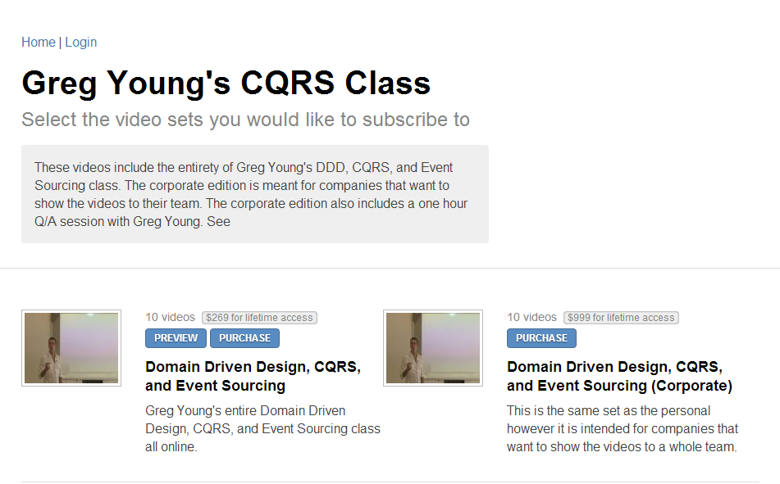

http://subscriptions.viddler.com/GregYoung
How -> watch some videos

Slide 50
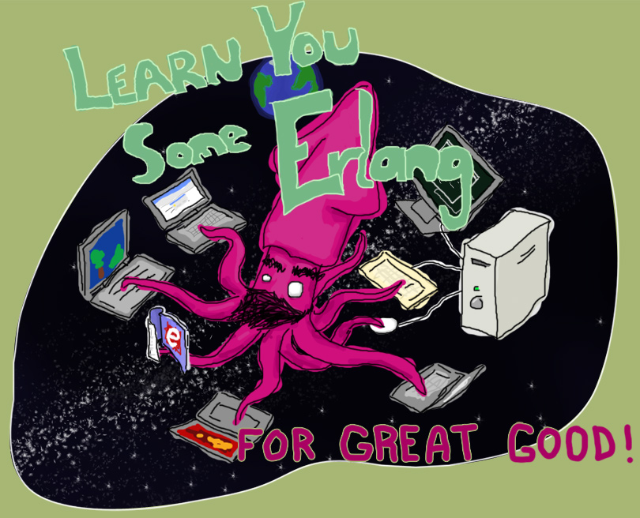
“Learn You Some Erlang for Great Good!” http://learnyousomeerlang.com/
How -> read this excellent and free online book

Slide 51



Start here
How -> read some books

Slide 52
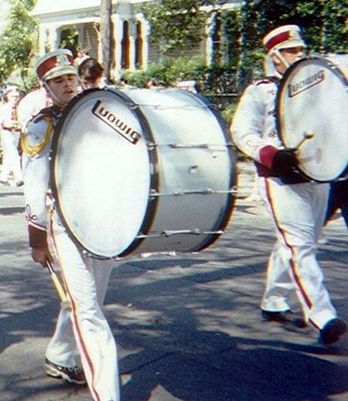


Start a polyglot FP group
λ
λ
http://nashfp.org
How -> Better yet; pack up and move to Nashville!

Slide 53
Thanks!
Bryan Hunter
Twitter: @bryan_hunter
Email: bryan.hunter@fireflylogic.com
Firefly Logic, Inc.
1000 Main Street #201 Nashville, TN 37206
http://fireflylogic.com
> keep in touch

